Slide 1
Energy-Efficient Neuromorphic Computing
Khritish Kumar Behera (17125)
khritish17@iiserb.ac.in
Advisor: Dr. Kuntal Roy, kuntal@iiserb.ac.in
EECS Dept., IISER Bhopal
MS Project: Mid-Term Presentation
30th September 2021

Slide 2
Content
Introduction to Artificial Neural Networks
Training and Testing Phase
Perceptron, Activation Function
Forward Propagation
Gradient Descent, Backpropagation
7x5 Character Recognition Model
Neural Network Using Spintronics
Magnetic Anisotropy
Potential Landscape of a Magnet
Magnetic Field applied in the Hard axis and Easy axis
Multiferroics
Design of Neural Network in Hardware
Experimental
Electromagnet
Magnetic Thermal annealing
Gaussmeter
Summary

Slide 3
Content
Introduction to Artificial Neural Networks
Training and Testing Phase
Perceptron, Activation Function
Forward Propagation
Gradient Descent, Backpropagation
7x5 Character Recognition Model
Neural Network Using Spintronics
Magnetic Anisotropy
Potential Landscape of a Magnet
Magnetic Field applied in the Hard axis and Easy axis
Multiferroics
Design of Neural Network in Hardware
Experimental
Electromagnet
Magnetic Thermal annealing
Gaussmeter
Summary

Slide 4
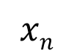
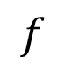
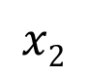
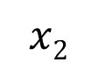
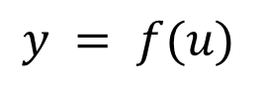
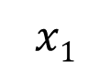
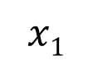
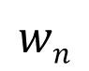

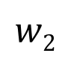
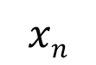
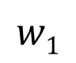
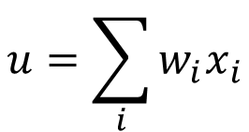
Energy-Efficient Neuromorphic Computing
$$u=\sum_{i}{w_{i}x_{i}}$$
Neuromorphic Computing is usually performed on traditional transistor based devices
$$x1$$
$$w1$$
$$y = f(u)$$
$$x2$$
$$w2$$
$$Σ$$
.
.
.
$$wn$$
Spintronic devices can be more energy-efficient than traditional transistors
$$f$$
$$xn$$
Y
Piezoelectric
Spintronic devices have inherent advantages over transistors
Weight, Sum and Threshold function
Non-volatile in nature
$$x1$$
$$x2$$
$$xn$$
.
.
Neuron
Read
Insulator
Non-Boolean Computing
Magnetostrictive
Write
Spintronics based Neuromorphic computer hardware can replace the transistor-based devices

Slide 5
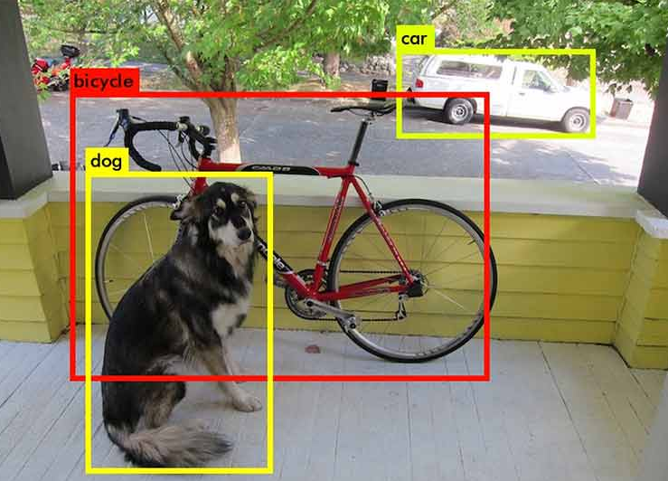

Artificial Neural Network: Motivation
Why Neural Network ?
Rise of Self Driving Car (Tesla)
Neuromorphic Computing hardware can be used in Tesla cars because Self driving cars used massive amount of Neural Network Computing
The Neuromorphic Computing Hardware can be implemented to run Deep Neural Network
Object Detection and Object Identification
Face Recognition in Airports
Face detection
Face Recognition
Notes:
Talk on success of ANN

Slide 6
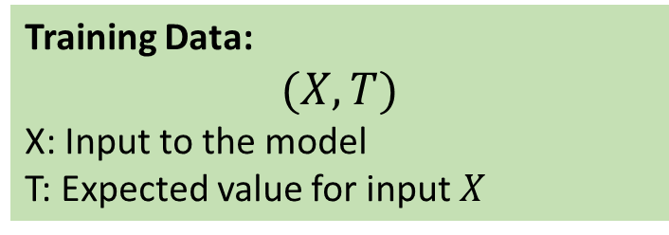
Artificial Neural Network: Training & Testing Phase
Neural Network is a two-phase process
Training Phase
Evaluation Phase
Training Phase
Learns the underlying feature, mapping function between I/P and O/P
Constructs that weights and bias
Evaluation Phase
Once the modeled is trained, new input data are feed into the model which were never used in the training phase
Training Data:
$$(X,T)$$
X: Input to the model
T: Expected value for input $X$
ERROR: T - O
Input data is feed into the model
The model gives some output, form which the error is calculated
Based on the error, the tunning parameter of the model is changed
X
O

Slide 7
Artificial Neural Network
An Artificial Neural Network is a system of
connected artificial neurons
Output of each neuron of one layer is connected to the all the other neurons in the next layer
There are no self loops, no feedback loops

Slide 8
Artificial Neural Network
Input Layer
Simply transfer the input to next layer without altering
No. of neurons depends on the problem at hand
Hidden Layer
At least one hidden layer
At least one hidden neuron per hidden layer
Output Layer
Final output of the neural network
No. of neurons depends on the problem at hand

Slide 9
Artificial Neural Network: Example
Character Recognition Model:
Each pixel value (1 or 0) is given to the model as input
Based on the training data, the network is constructed
A
.
.
.
.
.
.
Even if the characters are slightly perturbed, we can still recognize it
Deep Neural Network has defeated world champion of the Go game (4:1)

Slide 10
Artificial Neural Network: Perceptron
X1
W1
b
Perceptron is the basic unit of an Artificial Neural Network
X2
W2
∑
σ
Y
X3
W3
A perceptron can have more than one input
Each input edge has a weight associated with it
Each node has a ‘bias’ term associated with it
Two sequential processes:
Summation and
Activation

Slide 11
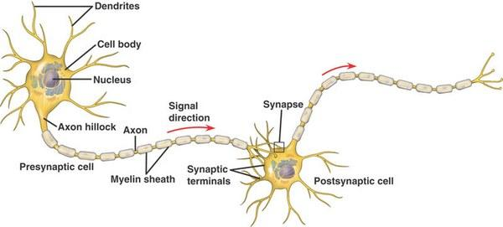
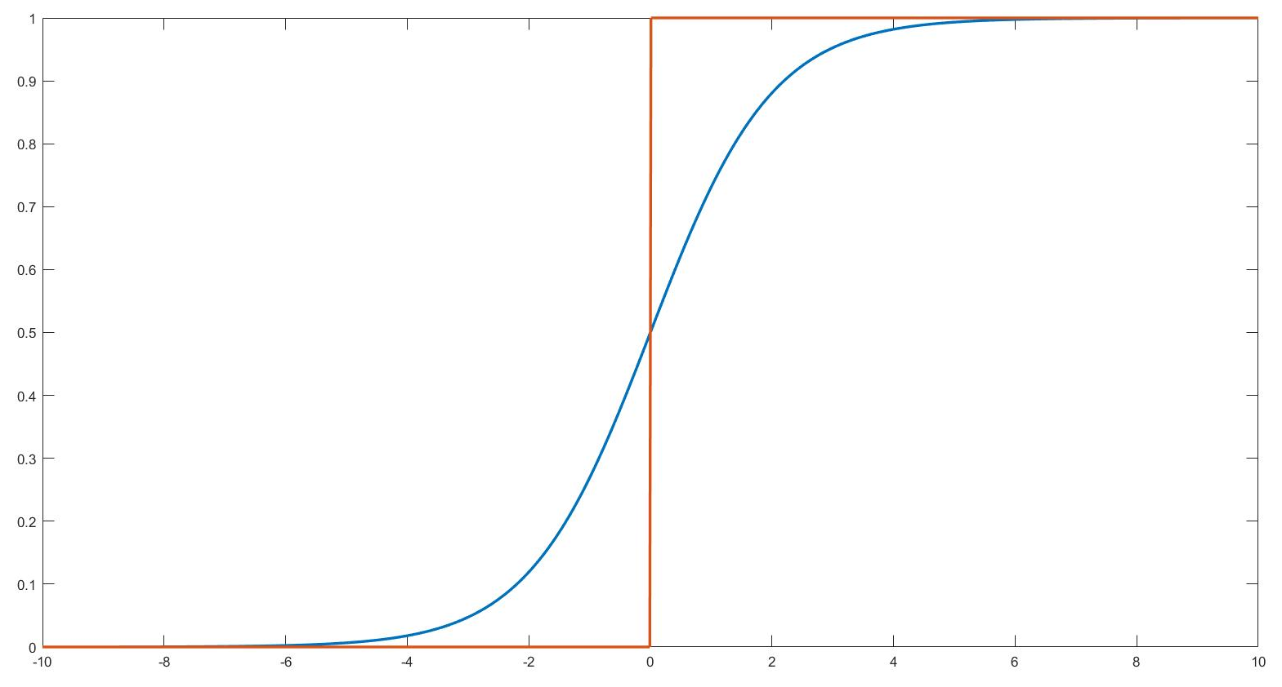
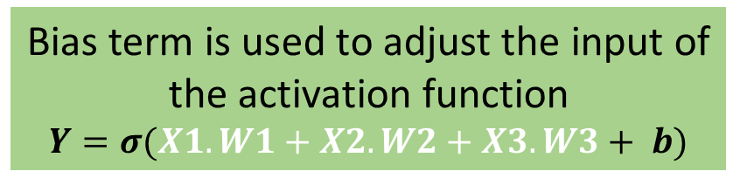
Artificial Neural Network: Activation Function
Activation function is a non-linear mathematical function
Bias term is used to adjust the input of the activation function
$$Y=σ(X1.W1+X2.W2+X3.W3+ b)$$
Activation Function is inspired from biological neuron
Neurons would not fire, and pass the input signal to the next neuron until and unless certain threshold is reached
Threshold

Slide 12
Artificial Neural Network: Activation Function
Non-Linearity of Activation Function is the super-power of Artificial Neural Network
Output
Output
Input
Input
The orange circle and the red square are linearly classifiable
The orange circle and the red square are not linearly classifiable

Slide 13
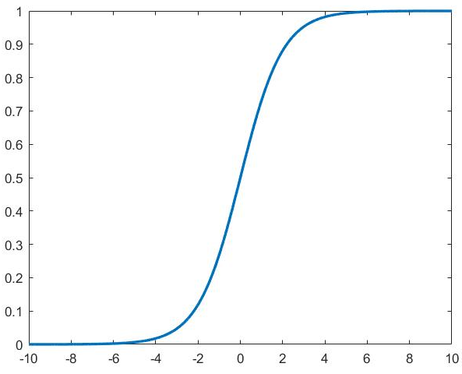
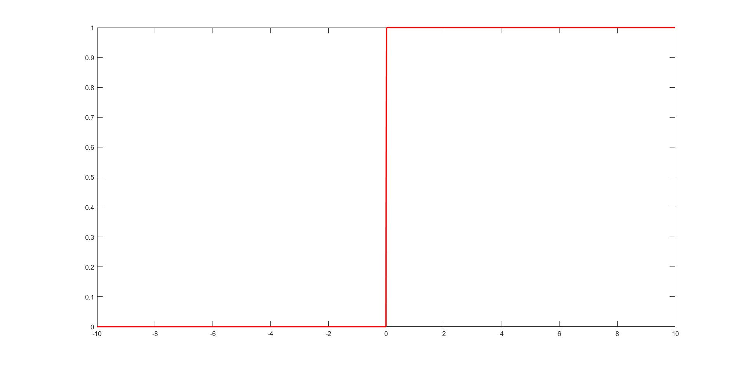
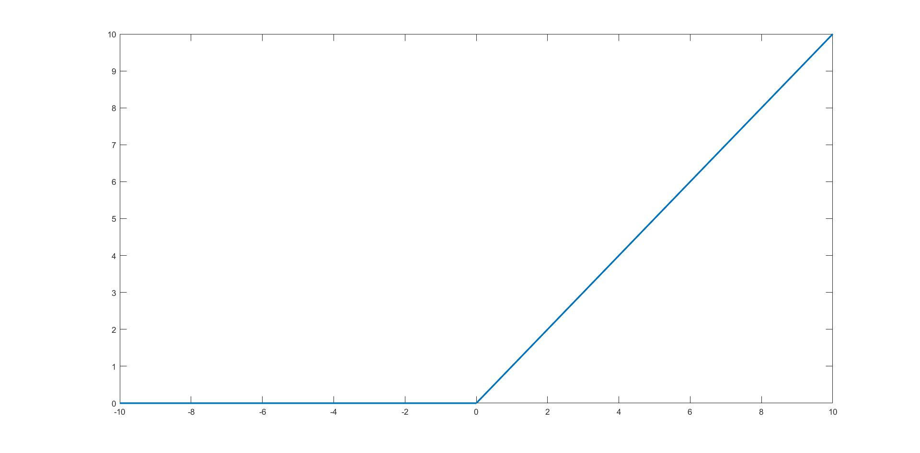
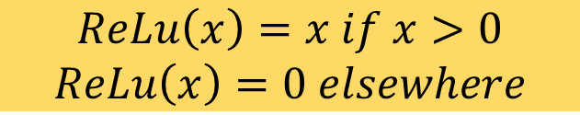
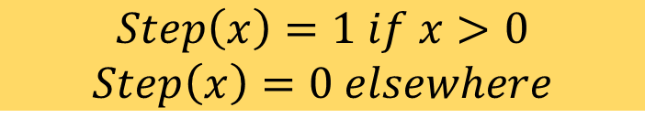
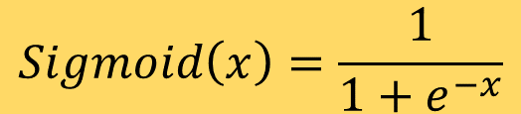
Artificial Neural Network: Activation Function
$$Step\left(x\right)=1 if x>0$$
$$Step\left(x\right)=0 elsewhere$$
$$Sigmoid\left(x\right)=\frac{1}{1+e^{−x}}$$
Rectilinear Unit Function (ReLu)
$$ReLu\left(x\right)=x if x>0$$
$$ReLu\left(x\right)=0 elsewhere$$
Notes:
Why ReLu is no bounded?

Slide 14
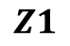
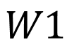
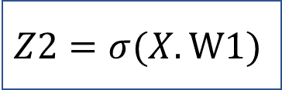
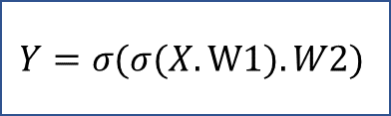
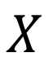
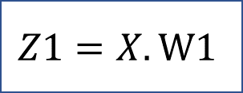
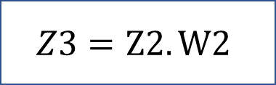
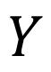
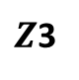
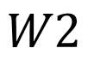
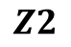
Artificial Neural Network: Forward Propagation
$$W1$$
$$Z1$$
$$Z2$$
$$W2$$
$Z$3
$$X$$
1
2
3
$$Y$$
$$Z1=X.W1$$
$$Z2=σ(X.W1)$$
$$Z3=Z2.W2$$
$$Y=σ(σ(X.W1).W2)$$
Input traversal from Input layer to Output layer through hidden layer

Slide 15
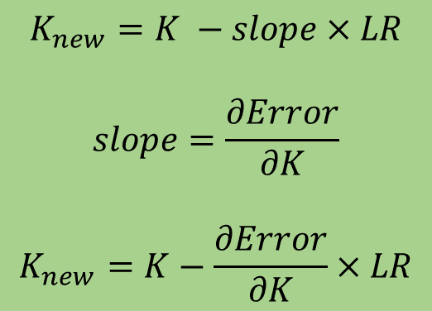
Artificial Neural Network: Gradient Descent
Error
Initial Point
$$K_{new}=K −slope×LR$$
$$slope=\frac{∂Error}{∂K}$$
$$K_{new}=K−\frac{∂Error}{∂K}×LR$$
K (Optimizing Parameter)
LR : Learning Rate

Slide 16
Artificial Neural Network: Gradient Descent
Error
K (Optimizing Parameter)
K is chosen randomly to increase the probability to not get stuck in a local minima
Getting stuck in local minima is un-avoidable but can be minimized

Slide 17
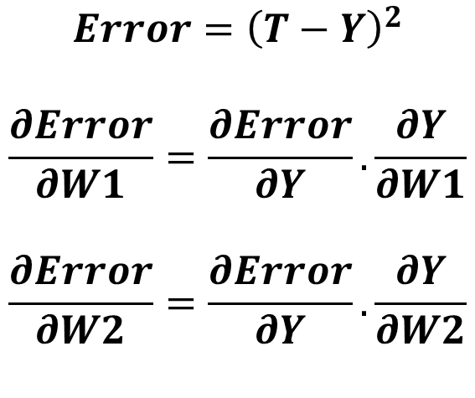
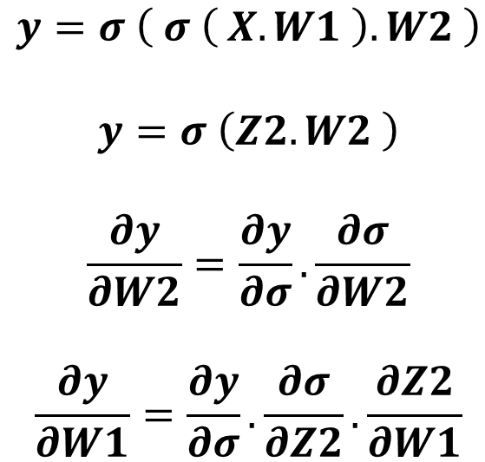
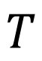
Artificial Neural Network: Backpropagation
$$T$$
Target
$$W1$$
$$Z2$$
$$W2$$
$$X$$
1
2
3
$$Y$$
$$y=σ \left( σ \left( X.W1 \right).W2 \right)$$
$$y=σ \left(Z2.W2 \right)$$
$$\frac{∂y}{∂W2}=\frac{∂y}{∂σ}.\frac{∂σ}{∂W2}$$
$$\frac{∂y}{∂W1}=\frac{∂y}{∂σ}.\frac{∂σ}{∂Z2}.\frac{∂Z2}{∂W1}$$
$$Error={\left(T−Y\right)}^{2}$$
$$\frac{∂Error}{∂W1}=\frac{∂Error}{∂Y}.\frac{∂Y}{∂W1}$$
$$\frac{∂Error}{∂W2}=\frac{∂Error}{∂Y}.\frac{∂Y}{∂W2}$$

Slide 18
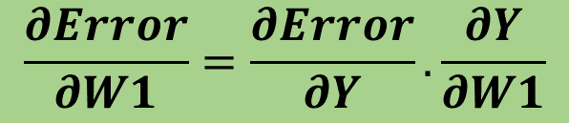

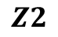

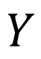
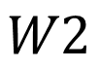
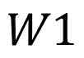
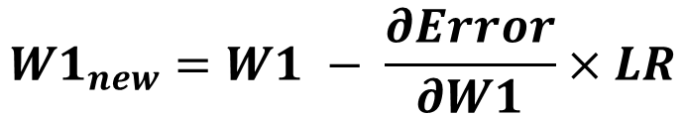
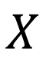
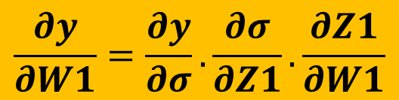
Artificial Neural Network: Backpropagation
$$W1$$
$$Z2$$
$$W2$$
$$X$$
1
2
3
$$Y$$
$$W1$$
$$Z2$$
$$W2$$
$$Y$$
$$X$$
$$σ$$
$$σ$$
Error
$$\frac{∂Error}{∂W1}=\frac{∂Error}{∂Y}.\frac{∂Y}{∂W1}$$
$$\frac{∂y}{∂W1}=\frac{∂y}{∂σ}.\frac{∂σ}{∂Z1}.\frac{∂Z1}{∂W1}$$
$$W1_{new}=W1 − \frac{∂Error}{∂W1}×LR$$

Slide 19
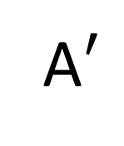
Artificial Neural Network: Character Recognition
We wish to create an ANN which can recognize alphabets from a noisy 7x5 pixel binary pattern
Original
Noise
A
A$′$

Slide 20
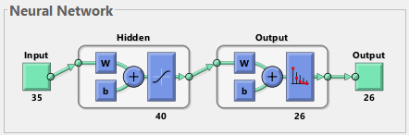
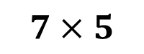
Artificial Neural Network: Neural Architecture
$$7×5$$
Input
35 (7x5)-bit word of the test character
Output
26-bit word suggesting the character
Input
A: 01110 10001 10001 11111
10001 10001 10001
Output
A: 10000000000000000000000000
B: 01000000000000000000000000

Slide 21





Artificial Neural Network: Noise Tolerance
ORIGINAL
ORIGINAL
D
$$✓$$
D
$$✓$$
$$✓$$
F
F
ORIGINAL
ORIGINAL
$$✓$$
J
J
H
H
$$✓$$

Slide 22
Artificial Neural Network: Noise Tolerance
ORIGINAL
ORIGINAL
✗
✗
H
A
P
F
ORIGINAL
ORIGINAL
✗
✗
Q
O
E
B

Slide 23
Content
Introduction to Artificial Neural Network
Training and Testing Phase
Perceptron, Activation Function
Forward Propagation
Gradient Descent, Backpropagation
7x5 Character Recognition Model
Neural Network Using Spintronics
Magnetic Anisotropy
Potential Landscape of a Magnet
Magnetic Field applied in the Hard axis and Easy axis
Multiferroics
Design of Neural Network in Hardware
Experimental
Electromagnet
Magnetic Thermal annealing
Gaussmeter
Summary

Slide 24
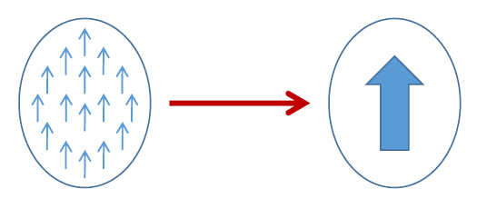


Spintronics: Spin-Electronics
Spin
Spin
Spin Up (↑) / Down (↓)
0 / 1
Charge
A rapidly developing nanotechnology
Spintronic devices are non-volatile and endurable
Advantage over transistors (requires extra circuitry )
Electron
Along with charge, electrons have spin
There is no charge movement, only spin rotation
No ohmic $I^{2}R$ energy dissipation
There is dissipation due to magnetization damping
There is dissipation due to applying external charge voltage/current
Electron beam lithography (EBL)
$$<100 nm$$

Slide 25














Magnetic Anisotropy
CoFeB
Sphere
Ellipsoid
Elliptical Cylinder
No anisotropy
Difficult to fabricate
In-plane Shape anisotropy
$$E=\frac{1}{2}Ωμ_{0}M_{s}H_{k}\sin^{2}{θ}$$
x
30-80 KT at 300 K
$H_{k}:$Coercive field
Magnetization
$Ω:$ Volume
$$E barrier$$
$$ϕ$$
$$θ$$
M
z
y
H
$$φ=±90^{o}$$
H_{k}
$$θ={180}^{o}$$
$$θ=0^{o}$$

Slide 26






Giant Magneto-Resistance (GMR)
Giant Magneto-Resistance (GMR)
$$GMR=\frac{1−0.55}{0.55}×100≃80\%$$
$$\text{Fe}$$
$$\text{Cr}$$
$$\text{Fe}$$
1988
A. Fert, M.N Baibich et al., Phys. Rev. Lett. 61, 2472 (1988)
P. Grunberg, G. Binash et al., Phys. Rev. B 39, 4828 (1989)
$$GMR[\%]=\frac{R\left(0\right)−R(H)}{R(H)}=\frac{RAP−RP}{R_{P}}×100$$
Notes:
Magneto resistance: With the effect of magnetic field, how resistance get changed.

Slide 27









Tunneling Magneto-Resistance (TMR)
Insulator
e.g., Al₂O₃, MgO
Conductance is proportional to the density of states
N_{L}↑, N_{R}↑, N_{L}↓, N_{R}↓
Left (L)
Right (R)
Left (L)
Right (R)
$$G^{↑↑}∝N_{L}^{↑}{ N}_{R}^{↑}$$
$$G^{↓↓}∝N_{L}^{↓}{ N}_{R}^{↓}$$
$$G^{↓↑}∝N_{L}^{↓}{ N}_{R}^{↑}$$
$$G^{↑↓}∝N_{L}^{↑}{ N}_{R}^{↓}$$
$$EF$$
$$TMR=\frac{GP−G_{AP}}{GAP}$$
Reported 1975 (prior to GMR)
$${GP=G}^{↑↑}+ G^{↓↓}$$
$${GAP=G}^{↓↑}+G^{↑↓}$$
Julliere, M. Tunneling between ferromagnetic film. Phys. Lett. A 54, 225-226 (1975)
Moodera, J. S. et al., Phys. Rev. Lett. 74, 3273 (1995)
Mathon, J. et al., Phys. Rev. B 63, 220403 (2001), Butler, W. et al., Phys. Rev. B 63, 054416 (2001)
Yuasa, S. et al., Nature Mater. 3, 868 (2004), Parkin, S. et al., Nature Mater. 3, 862-867 (2004)

Slide 28





Multiferroics and Multiferroic Composites
Multiferroic
Magnetostrictive
Room-temperature operation
Weak magnetoelectric coupling
Piezoelectric
Strain
E
E
Piezoelectricity
Magnetoelectricity (intrinsic)
Piezoelectricity
Magnetoelectricity (intrinsic)
P
P
$$ε$$
M
$$ε$$
M
$$σ$$
H
$$σ$$
H
Magnetostriction
Magnetostriction
$$\boxed{α_{ME}=μ_{0}\frac{∂M}{∂E}}$$
$$\boxed{α_{ME}=μ_{0}\frac{∂M}{∂σ}\frac{∂σ}{∂E}}$$
Notes:
Change it to multiferroic composites

Slide 29







Magnetostriction
Magnetostrictive Material : Certain ferromagnetic specimen changes its shape (strain$ε$:$∂l/l$) during the process of magnetization
Magnetostrictive Anisotropy ↔ Stress Anisotropy
$$−\frac{3}{2}λ σ Ω \cos^{2}θ$$
$λ:$ Magnetostriction Co-efficient
$$σ:Stress$$
$$Ω:Volume$$
Cobalt:
$$\frac{3}{2}λ=−30×{10}^{−6}$$
FeGa:
$$\frac{3}{2}λ=150×{10}^{−6}$$
$$σ=Yε=Yd\frac{V}{t}$$
Notes:
40KT =1eV=1.610-19J

Slide 30




Multiferroic composites Voltage vs stress anisotropy
V_{in}
$$ε_{piezo}=d_{piezo}×\left(\frac{V_{in}}{t_{piezo}}\right)$$
$$ε_{mag}≃ε_{piezo}$$
$$σ=Yε_{mag}$$
Magnetostrictive
Piezoelectric
t_{piezo}
strain transfer
Choose piezoelectric layer with high de-coefficient
Y: Young’s modulus
Magnetostrictive layer
with high $λ_{s}Y$
Stress Anisotropy (for FeGa):
$\frac{3}{2}λ σ Ω \cos^{2}θ$
$=2.4×{10}^{−18} J$ (max.)
$$d=3000 pm/V$$
$$Y=250×{10}^{9} Pa$$
$$t=100 nm$$
$$V=50 mV$$

Slide 31








Design of Neural Network
Electric Potential
Stress in Piezoelectric
Stress in Magnetostrictive
Changes the magnetization direction in the lower plate of TMR
Changes magnetization of Magnetostrictive
Creates different resistance
ReadMTJ
Insulator
$$x1$$
Magnetostrictive
Write
$$w1$$
$$y = f(u)$$
$$x2$$
$$w2$$
$$Σ$$
Piezoelectric
.
.
.
$$wn$$
x₁
$$f$$
x₂
$$xn$$
Neuron
x_{n}
.
.

Slide 32
Content
Introduction to Artificial Neural Network
Training and Testing Phase
Perceptron, Activation Function
Forward Propagation
Gradient Descent, Backpropagation
7x5 Character Recognition Model
Neural Network Using Spintronics
Magnetic Anisotropy
Potential Landscape of a Magnet
Magnetic Field applied in the Hard axis and Easy axis
Multiferroics
Design of Neural Network in Hardware
Experimental
Electromagnet
Magnetic Thermal annealing
Gaussmeter
Summary

Slide 33
Experimental
Electromagnet for magnetic alignment
Magnetic Thermal Annealing for better magnetic characterization
Gaussmeter for measuring the magnetic field
Sputtering for deposition of different materials, e.g., piezoelectric, magnets
Electron Beam Lithography (EBL) for patterning single-domain nanomagnets
Magnetic Force Microscopy (MFM) for visualizing single-domain nanomagnets
Ferromagnetic Resonance (FMR) for characterizing the magnetic damping parameter
Vibrating Sample Magnetometer (VSM) for magnetic hysteresis

Slide 34


Electromagnet
Chiller
Constant Current
Power Supply
Magnetic Coil
Gauss Probe
Magnetic Coil: When electric current is passed through the magnetic coils it generates a constant magnetic field
Gauss Probe: It is used to measure the magnetic field generated between the poles
Constant Current Power Supply: Provides a constant current to the magnetic coil which in turn a constant magnetic field
Chiller: Is required to reduces the temperature of the magnetic coil

Slide 35



Magnetic Thermal Annealing
Heater
Enhances the magnetic property of magnetic materials
Reorients the spin direction in the direction of the magnetic field
Heating of the sample is done in vacuum and the material MTA is made up of is not affected by the magnetic field
Vacuum Pump

Slide 36


Gaussmeter
Gauss Probe
Gaussmeter is a static electronic magnetic field measurement device
Probes used in Gaussmeter:
Axial Probe: Measures the magnetic field parallel to the probe
Transversal Probe: Measures the magnetic field perpendicular to the probe
It measures by the Hall effect, which is the conversion of magnetic field into Hall Voltage
Electrons in magnetic field tries to move in perpendicular direction of applied magnetic field (Lorentz force)

Slide 37
Summary
Understanding of the working principle of ANN
Implemented a 7x5 Character Recognition Model
Learned about spintronics, magnetic anisotropy, multiferroics and magnetostriction
Working on a proposal of a spintronic artificial neuron for energy-efficient neuromorphic computing
Worked on Electromagnet, Magnetic Thermal Annealing and Gaussmeter
Future Works
Will learn more about spintronic devices
Will learn other experimental apparatus e.g. sputtering, Electron Beam Lithography, Magnetic Force Microscopy, Ferromagnetic Resonance, Vibrating Sample Magnetometer
Design and fabrication of the proposed device
Notes:
Write in the perspective of what I have done until now and what I will do in the project

Slide 38










Gaussmeter
H↑
$$θ→$$
R = 2.5cm : $0^{0}<θ<{360}^{0}$
H↑
H↑
$$θ→$$
$$θ→$$
R = 3.6cm : $0^{0}<θ<{360}^{0}$
R = 5cm : $0^{0}<θ<{360}^{0}$

Slide 39










Gaussmeter
H↑
$φ$→
R = 2.5cm : $0^{0}<φ<{360}^{0}$
H↑
H↑
$φ$→
$φ$→
R = 3.6cm : $0^{0}<φ<{360}^{0}$
R = 5cm : $0^{0}<φ<{360}^{0}$

Slide 40
Thank You
?

Slide 41
Backup Slides

Slide 42
Artificial Neural Network: Setting Neural Architecture
No. of Hidden Layers ?
No. of neurons per hidden layers ?
Error
Optimal number of neurons (hidden layer)
Plot the testing and training error iterating from 1 to max hidden neuron
Consider those neuron where testing error has minima
Error Gap
Neurons no.
Testing Error
Training Error
Optimal number of hidden layer
Calculate the no. of hidden neuron for first layer
Using this no. calculate for second layer, continue until the error gap starts increasing
Optimal number of neurons in hidden layer
Error Gap:
(Testing Error – Training Error)
at the optimal hidden neuron

Slide 43

Artificial Neural Network: Perceptron
X1
W1
b
X2
W2
∑
σ
Y
1. Weighted input:
$$X1.W1, X2.W2, X3.W3$$
2. Summation of the weighted inputs
$$Σ_{i}X_{i}W_{i}=X1.W1+X2.W2+X3.W3$$
3. Addition of bias term to the weighted sum
$X1.W1+X2.W2+X3.W3+ b$
4. Apply activation form
$$Y=σ(X1.W1+X2.W2+X3.W3+ b)$$
X3
W3

Slide 44









Potential Landscape of Magnet
$$E_{shape}\left(θ,φ\right)=\frac{1}{2}μ_{0}M_{s}\left[H_{k}+ H_{d}\cos^{2}{φ}\right]Ω\sin^{2}θ$$
$$H_{k}=\left(N_{d_yy}−N_{d_zz}\right)M_{s}$$
$$H_{d}=\left(N_{d_xx}−N_{d_yy}\right)M_{s}$$
$$M_{s}=8×{10}^{5}\frac{A}{m}$$
$$\left(a,b,t\right)=\left(100nm, 90nm, 6nm\right)$$
$$N_{d}=(0.8529, 0.0788, 0.0683)$$
$$Energy$$
$$θ ( in degree)$$
$$φ ( in degree)$$
Notes:
Increase the axis font, plot phi 85-95

Slide 45







Magnetic Field applied along in-plane hard axis
$$E=\frac{1}{2}μ_{0}M_{s}H_{k}\sin^{2}{θ−μ_{0}M_{s}H_{y}\sin{θ }}$$
$$\frac{dE}{dθ}=0$$
$$\sin{θmin=\frac{H_{y}}{H_{k}} }$$
$$θmin=\sin^{−1}\left(\frac{H_{y}}{H_{k}}\right)$$
Magnetic Field applied along Y-axis
Notes:
Plot it, animation with magnetization direction

Slide 46



Magnetic Field applied along in-plane Easy axis
$$E=\frac{1}{2}μ_{0}M_{s}H_{k}\sin^{2}{θ−μ_{0}M_{s}H_{z}\cos{θ }}$$
$$θmin=\sin^{−1}\left(\frac{H_{z}}{H_{k}}\right)$$
Magnetic Field applied along Z-axis
Notes:
Plot it, animation with magnetization direction

Slide 47
Artificial Neural Network: Noise Tolerance
520 data of these 26 character were taken and added some noise degree ranging from 4-Bit to 8-Bit flip
4-Bit Flip
Correct Recognition: 0.913
Wrong Recognition: 0.087
7-Bit Flip
Correct Recognition: 0.5923
Wrong Recognition: 0.4077
5-Bit Flip
Correct Recognition: 0.7942
Wrong Recognition: 0.2058
8-Bit Flip
Correct Recognition: 0.4635
Wrong Recognition: 0.5365
6-Bit Flip
Correct Recognition: 0.7077
Wrong Recognition: 0.2923
Test Data with mix noises varying from 4-bit to 8-bit Results:
Correct Prob. = 0.7203
Wrong Prob. = 0.2797
Noise tolerance is up to 6-Bit flip

Slide 48



Artificial Neural Network: Noise Tolerance
ORIGINAL
4 BIT FLIP
5 BIT FLIP
$$✓$$
$$✓$$
A
A
8 BIT FLIP
7 BIT FLIP
6 BIT FLIP
✗
✗
$$✓$$
G
Q
A

